Slide 1
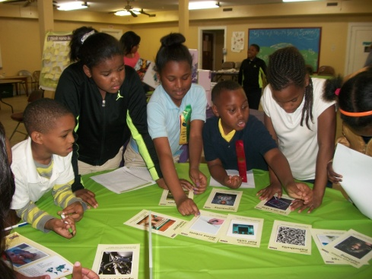
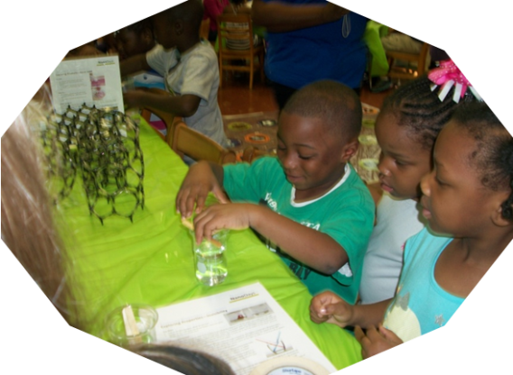
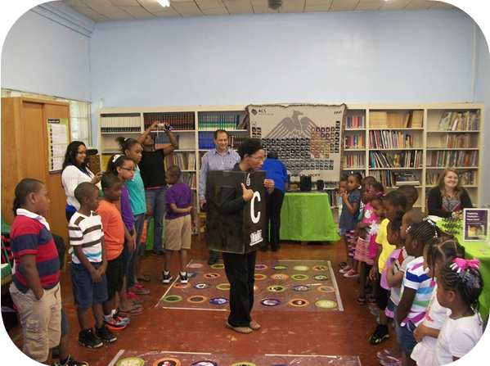
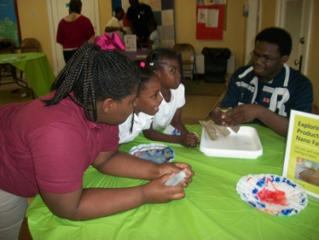
Nanotechnology Exhibition for Junior High School Participants Paresh Ray (Jackson State University), DMR-Award # 1205194
NSF-JSU-UCSB PREM members conducted outreach activities at local school and initiate a Science Line program to the minority participants.
PREM members discussed them that this field is an old science and we as a society are already using some of the technologies i.e. polymers, sunblocks, computer laptops, cell phones, solar panels, nanosilver socks and others.

