Slide 1
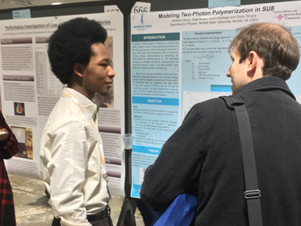
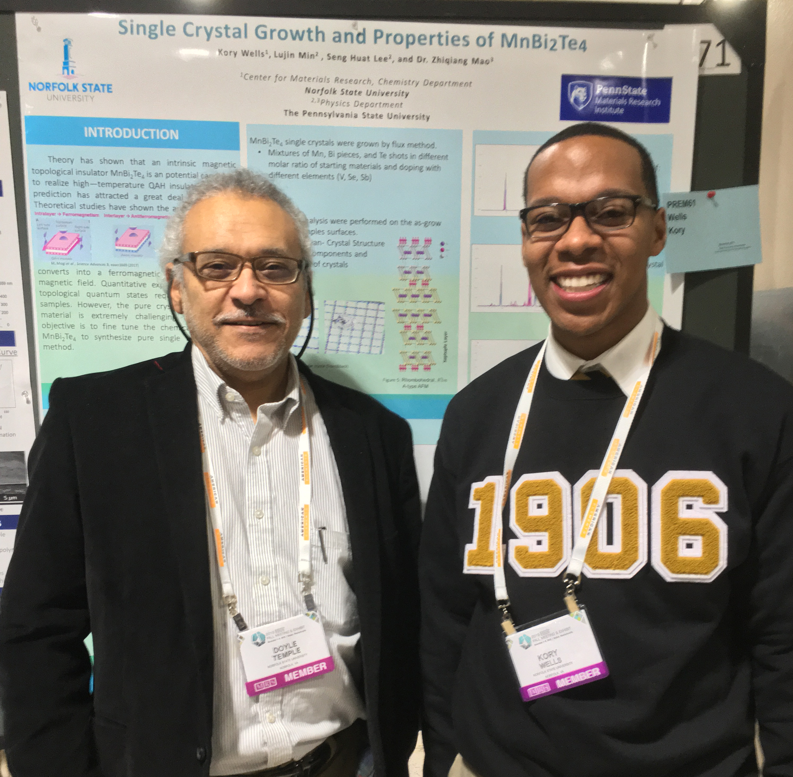
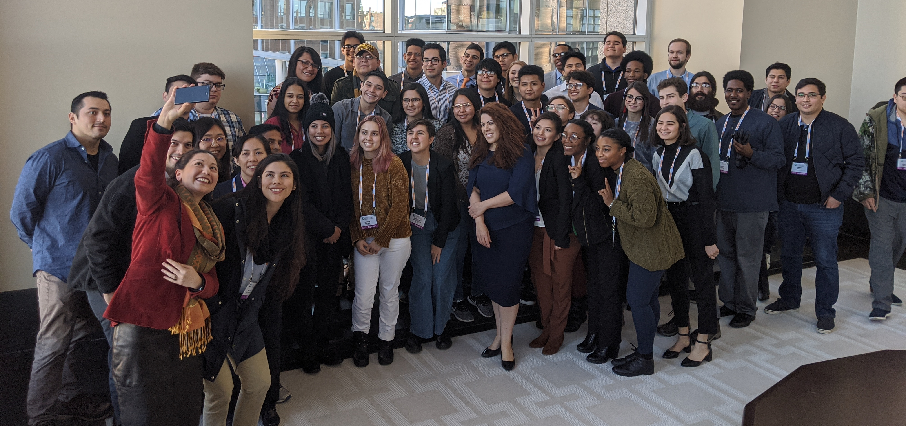
MRS Fall PREM Scholars Program
DMR 1827847
Jorge Nicholas (Nico) Hernandez Charpak, STROBE
PEAQS Co-PI, Dr. Hernández Charpak (STROBE) was one of 4 core organizers for the MRS-PREM Research Scholars Summit at MRS Fall 2019 in Boston, MA. He and Dr. Ellen Keister (STROBE) also served as mentors for the program. The program paired more than 30 graduate students and postdocs mentors from MRSECs and STCs with 60 students from PREM Minority Serving Institutions through the MRS Fall meeting, which, for many, was their first national conference. The program also provided students with professional development training, networking opportunities, and an opportunity to present their work at a dedicated poster session. The program was a great success, as more than 85% of the mentees found the program very useful. Moreover, more than 86% of the mentees and 50% of the mentors were URM, and PEAQS sent four undergraduate students and one graduate student to the program.
TOP left NSU undergraduate Baldwin Varner presenting his poster at MRS Fall. TOP right NSU undergraduate Kory Wells at his poster with his PI, Dr. Doyle Temple at MRS Fall. BOTTOM MRS Fall PREM Research Scholars line up for a selfie at the meeting.
Notes:
Needs technical description

