Slide 1
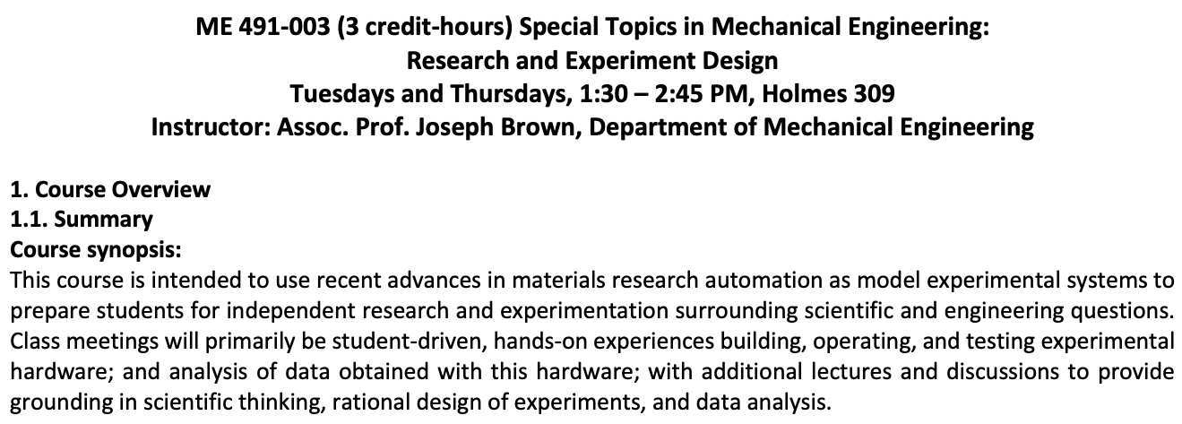
Educational Activities
DMR-2121848 PREM
UH: Brown (Thrust lead), Furutomo, Pham, Dera, Severa. UW: Pozzo, Hendrickson and Li
PI: Severa, University of Hawai‘i at Mānoa
Co-development of New Materials Course:
A new materials course titled “Research and Experiment Design” was co-developed by Co-PI Brown (UH) and Prof. Lilo Pozzo (UW).
The course is targeted to be offered annually at UH starting Fall 2022 semester, with guest lectures from UW faculty.
The course will initially use a “special topics” course number, ME491, to test the course content. Later, a course number request will be filed in order to add this course to the curriculum.
Advance registration filled the course enrollment: 14 students are currently registered for the course.
MRE-C Website
A new PREM website with educational content was developed.
The site includes basic content on materials science.
Provides background educational information on research thrusts.
MRE-C Faculty Co-teaching: Introduction to Materials Science (ME331)
Three MRE-C faculty co-taught ME331 materials course in Spring 2022 semester.
ME331 class announcements on the PREM research opportunities resulted in direct recruitment of 2 female students into PREM research thrusts.

