Slide 1
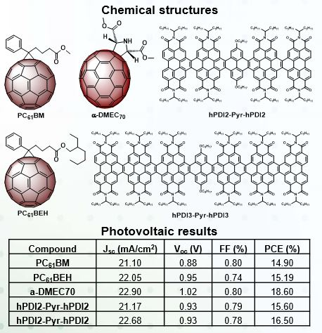
New Electron Extraction materials for Inverted Perovskite Solar Cells
DMR PREM - 1205302
2018
Perovskite solar cells (PSCs), have shown a remarkable increase in photoconversion efficiency (PCE), from 3.8% in 2009, to 22.1% in 2016. The good electron transporting and solution processable properties of fullerene derivatives make them the most popular electron transporting materials (ETMs) in PSCs. The influence of different adducts on the PCEs of fullerene-based PSCs has not been fully explored to date.
Outcome: We reported new functionalized carbon nanomaterials, and PCEs up to 18.6% were obtained when they were used as the ETMs in PSCs.
1. E. Castro, G. Zavala, S. Seetharaman, F. D'Souza and L. Echegoyen. J. Mater. Chem. A. 2017, 5, 19485-19490.
2. E. Castro, T. J. Sisto, E. L. Romero, F. Liu, S. R. Peurifoy, J. Wang, X. Zhu, C. Nuckolls and L. Echegoyen. Angew. Chem. Int. Ed. 2017, 129, 14840-14844.
3. E. Castro, J. Murillo, O. Fernandez-Delgado and L. Echegoyen. J. Mater. Chem. C. 2018, 6, 2635-2651.
4. C.-B. Tian, E. Castro, G. Betancourt-Solis, Z.-A. Nan, O. Fernandez-Delgado, S. Jankuru and L. Echegoyen. New J. Chem. 2018, 42, 2896-2902.
Dr. Luis Echegoyen, The University of Texas at El Paso

