Slide 1
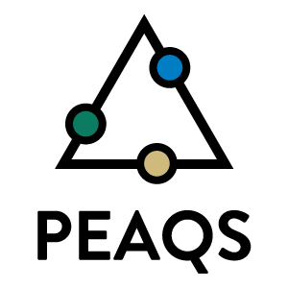
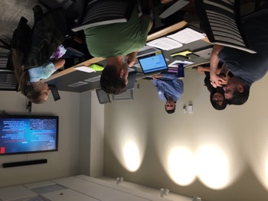
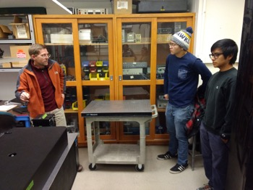
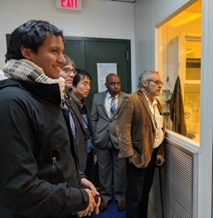
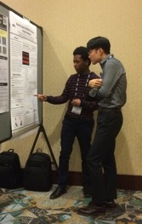
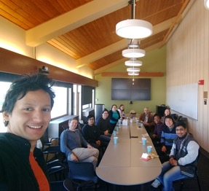
Partnership for the Education and Advancement of Quantum-and nano-Systems (PEAQS)
DMR 1827847
Jeff Jessing, Fort Lewis College
Building Center Community
PEAQS is a partnership between Fort Lewis College, Norfolk State University, and the NSF Science and Technology Center, STROBE. Woven throughout PEAQS are highly collaborative materials science research and education projects requiring a strong center community and confident, empowered undergraduate researchers. In the first 9 months of PEAQS, an emphasis was made to strengthen the PEAQS community and empower our undergraduate researchers through:
6 cross institutional exchanges across all PEAQS nodes, involving >17 faculty, staff, and students leading to numerous collaborative projects
Week long research experience at CU Boulder for two FLC undergraduate researchers
Numerous oral and poster presentations given by PEAQS undergraduate researchers
Peer network building at all institutions through active student groups
Center community building events (clockwise from top left)
FLC students build communication skills and peer network with their advisors. FLC students spend a week in a STROBE group at CU Boulder. Students, faculty, and staff from all three PEAQS nodes meet to discuss projects. NSU undergraduate gives poster presentation at SPIE conference. Faculty and staff from STROBE and FLC tour NSU labs.

