Slide 1
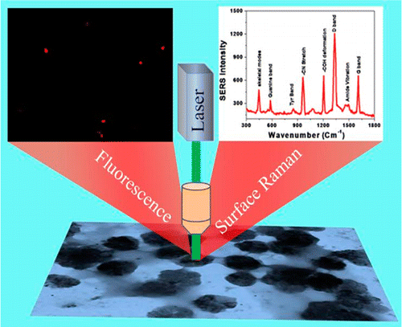
Plasmonic–Magnetic 3D Graphene Oxide Architecture Can Pick and Separate Rotavirus Paresh Ray (Jackson State University), DMR-Award # 1205194
According to the World Health Organization (WHO), more than 1.5 million children die each year due to rotavirus contamination in drinking water.
We have demonstarted selective rotavirus identification as well as removal from a water sample using plasmonic–magnetic hybrid graphene oxide based three-dimensional (3D) solid architectures
Published in J. Phys. Chem. Lett., 2014, 5, 3216–3221

