Slide 1
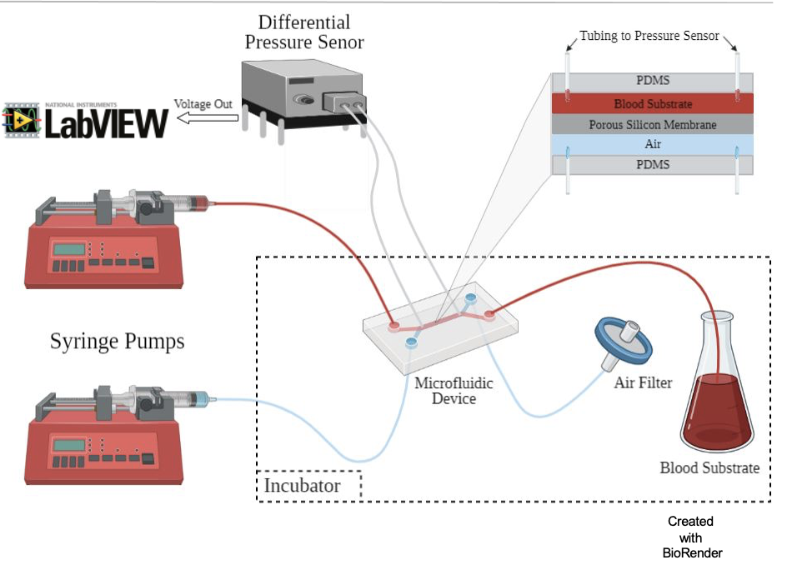
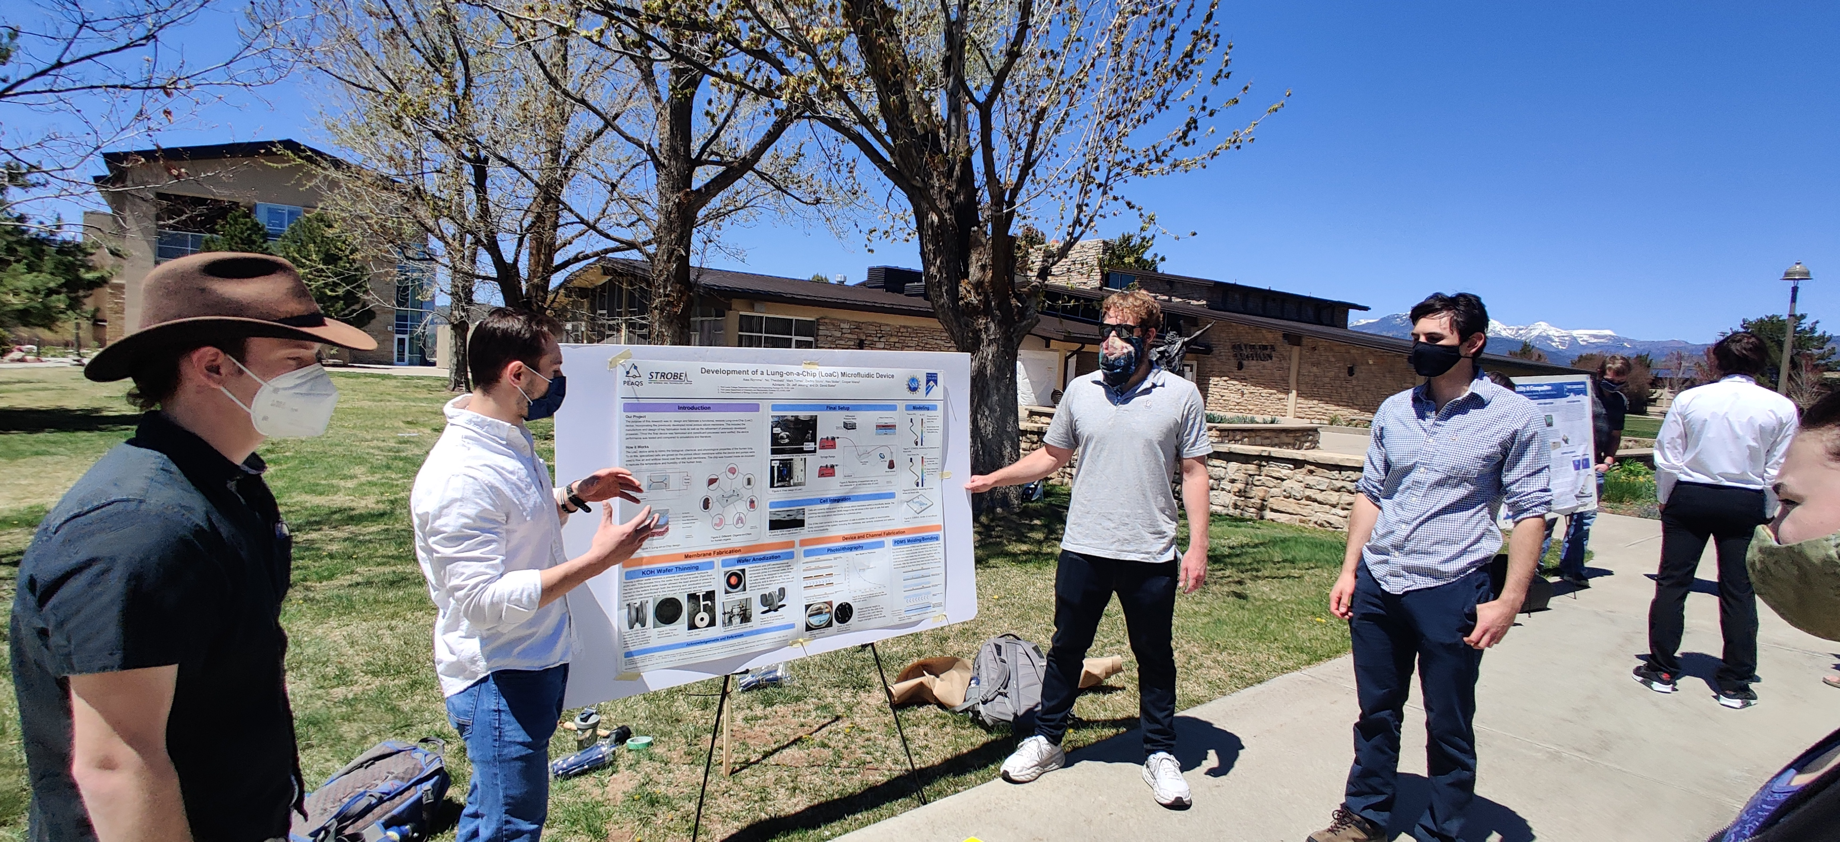
Integration of a Novel Biomembrane into a Lung-on-a-Chip Microfluidic Test-Platform
DMR 1827847
Jeff Jessing, Fort Lewis College
The Lung-on-a-Chip team at Fort Lewis College developed a novel fabrication method to produce a viable porous silicon biomembrane that mimics the functionality of the human interstitial space that separates the alveolar cells and the capillary cells where the gas exchange occurs in the lungs. This membrane has been successfully integrated into a test-platform in the form of a microfluidic device that allows for studies of interactions between different types of tissues within the lungs, mechanical and structural effects on the membrane and provides a live cell imaging platform (Fig top). The most recent efforts on this project were performed by undergraduate scholars in the form of interdisciplinary senior capstone project team from the Physics & Engineering department. The undergraduate scholars showed that both alveolar and capillary cells can grow successfully within this microfluidic device and are currently submitting a manuscript of their results.
TOP Schematic for the microfluidic Lung on a Chip device designed at Fort Lewis College. BOTTOM Senior Capstone team presenting their work at the FLC Spring Research Symposium (left to right: Nic Theobald, Zachry Szura, Alex Romme, and Mark Torres)
Notes:
A new technique has recently been developed based on biomimetic engineered systems commonly referred to as an organ-on-a-chip (OoC). An OoC provides a microenvironment that mimics the structural and mechanical properties of human organ more adequately than both in vitro studies and animal testing. These provide a convenient platform to sustain and transport live tissue into different imaging modalities for high resolution imaging. Recently, PEAQS undergraduate student researchers working with Professors Jessing and Blake group (FLC) have made substantial progress to create a lung-on-a-chip. To create an OoC that mimics this alveolar-capillary interface, this PEAQS team created a synthetic material that mimics the structural and mechanical properties of the interstitial space as a platform to grow the epithelial and endothelial cells. Instead of taking the traditional approach of using a micropatterned polydimethylsiloxane (PDMS) membrane to mimic the interstitial fluid, this PEAQS team developed a chemical process to thin silicon membranes down to a few microns in thickness and an electrochemical anodization process to produce nanopores in the thinned membranes to better mimic the biological interface. These membranes support the growth of epithelial and endothelial cells in a manner similar to the interface seen in a lung. Students are currently working on a manuscript of these results.

