Slide 1
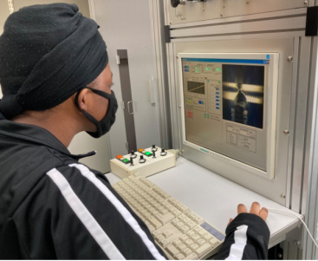
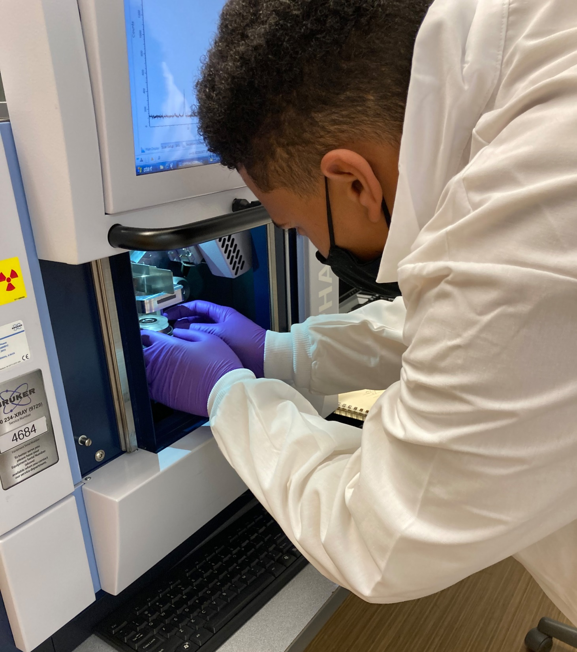
Collaborative materials characterization
DMR 1827847
PEAQS has successfully leveraged the new laboratory space allocated to the project during years 1 and 2 to begin a successful program in single crystal growth of quantum materials. This work has also led to the award of a $500k Department of Defense instrumentation grant for a new x-ray powder pattern diffractometer and an x-ray single crystal Laue diffractometer which are needed for characterization of the the crystals grown by PEAQS students. The Laue diffractometer will be the only one in the located within a 500 mile radius of NSU. Additional laboratory space for the the project has been allocated for installation of the x-ray equipment on the first floor of the NSU McDemmond Center for Applied Research. Additionally, the crystal growth results were reported by students in two posters and one talk at the spring MRS conference.
Doyle Temple, Norfolk State University
TOP left NSU undergraduate Tekiyah Robinson starting a crystal growth run of CuBi₂O₄ . TOP right NSU undergraduate, Liam Harrigan setting up a sample for x-ray diffraction. BOTTOM Single crystals grown by PEAQS students in the new NSU crystal growth laboratory.
Notes:
Needs technical description

