Slide 1
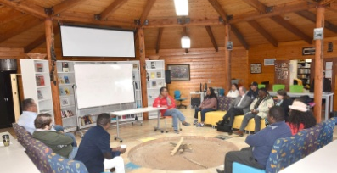
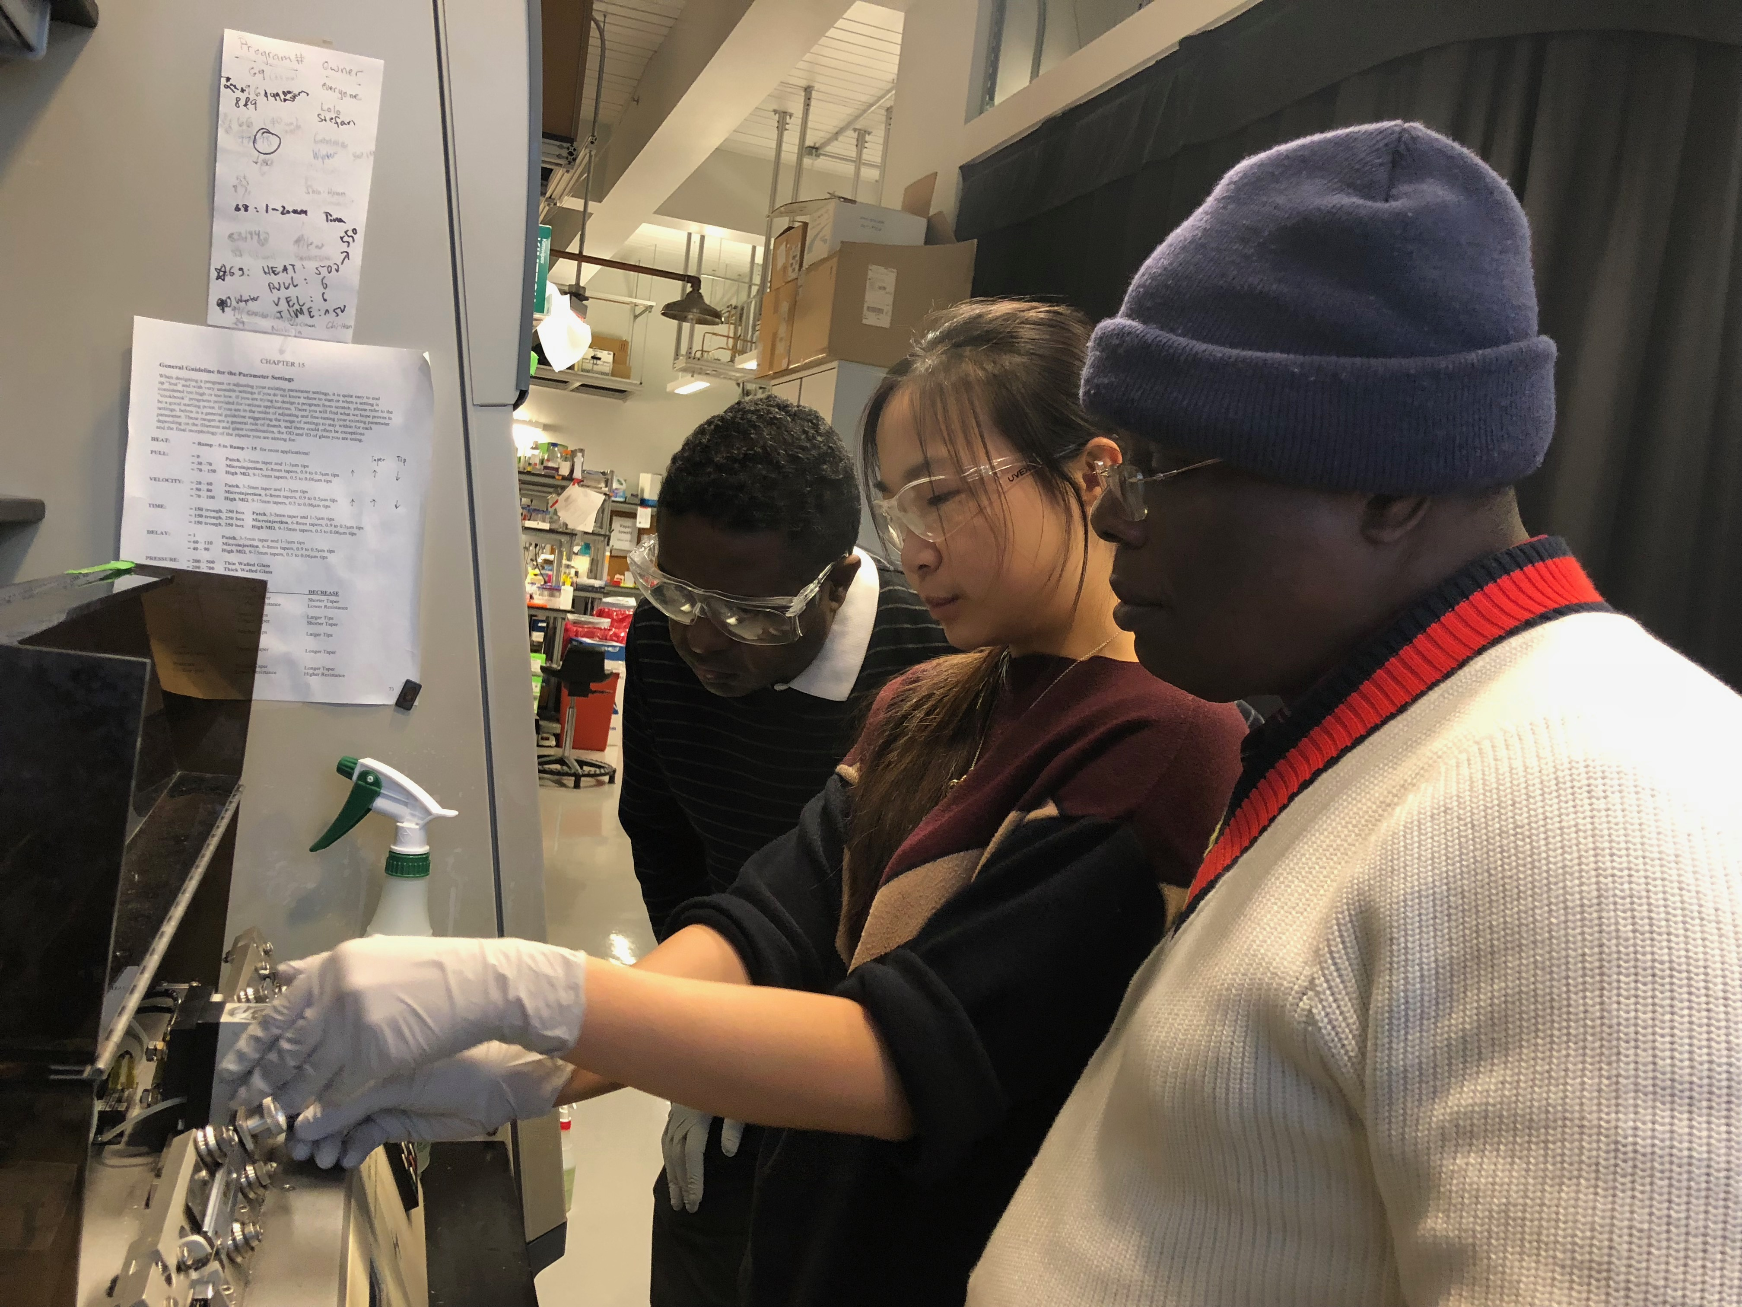
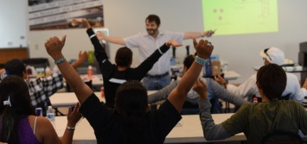
PREM Seed: VENTURES
Navajo Technical University
DMR-1828012
2018-2019
Thiagarajan Soundappan (Chemistry)
Vision for Excellence at Navajo Technical University in Research and Education in STEM
Education Pathways
Increase education infrastructure at NTU
Increase enrollment of Navajo in STEM
Enrich NTU Science and Engineering Courses with hands-on projects
Partnership
Build a culture of research at NTU
Develop culturally congruent research program between Harvard and NTU to increase research infrastructure at NTU
Uranium in water
Diabetes
Detection and reduction
Low cost -rapid diagnosis
Community Engagement
Develop cultural competency in research mentors at Harvard
Transfer of Diné education and inquiry principles
Research
Fabricating vesicles with cholesterol analog molecules inserted in membranes
Low-cost electrochemical sensors
3D Printing of microfluidic device for encapsulation of actives

