Slide 1
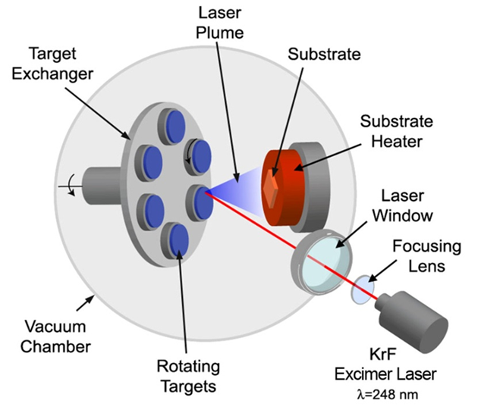
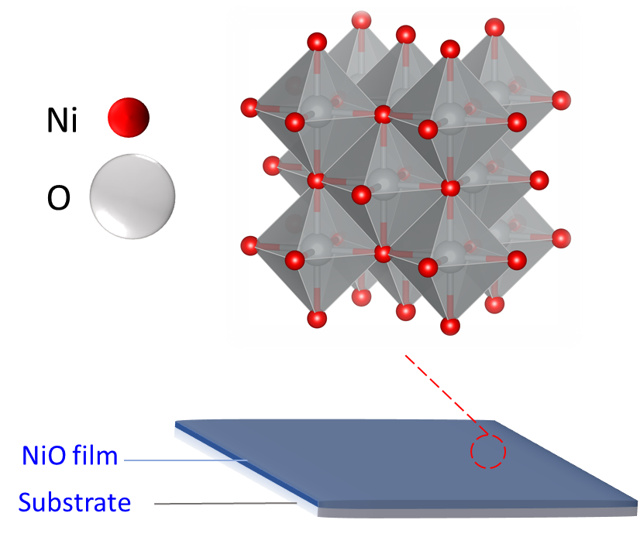
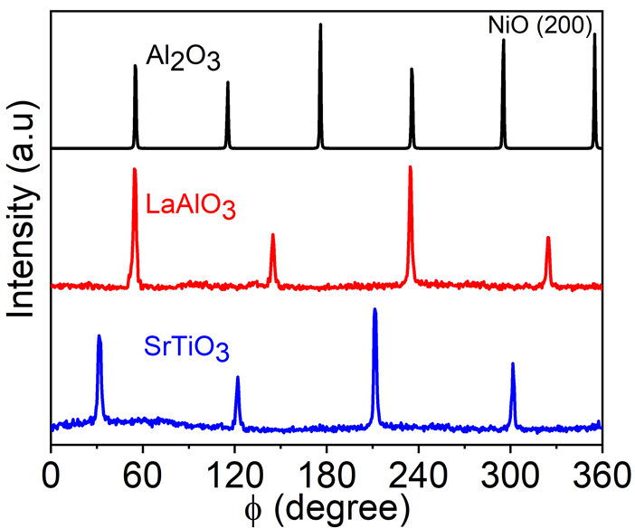
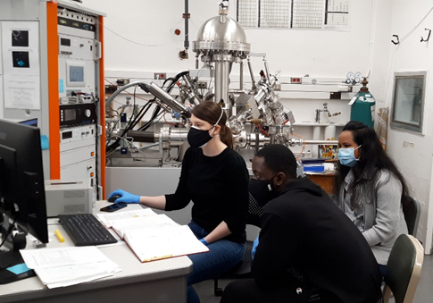
Collaborative Research and Education in Energy Materials (CREEM)
DMR-2122067 PREM
North Carolina A & T State University and Cornell University
Schematic of a PLD Process
NiO is a p-type oxide semiconductor with excellent electrochemical Performance
Effect of lattice strain in the NiO thin films on the hydrogen evolution reaction overpotential have been studied
Epitaxial nature of the NiO films on three substrates was confirmed by the phi scan of Ni (200) peak
NCAT-PREM students (Jacob Som and Manosi Roy) working in the XPS lab of the Cornell Center for Materials Research (CCMR)
Jacob Som, J. Choi, H. Zhang, N.R. Mucha, S. Fialkova, K. Mensah-Darkwa, J. Suntivich, R.K. Gupta, D. Kumar, “Effect of substrate-induced lattice strain on the electrochemical properties of pulsed laser deposited nickel oxide thin film, Materials Science and Engineering B, Volume 280, June 2022, 115711, https://doi.org/10.1016/j.mseb.2022.115711

