Slide 1
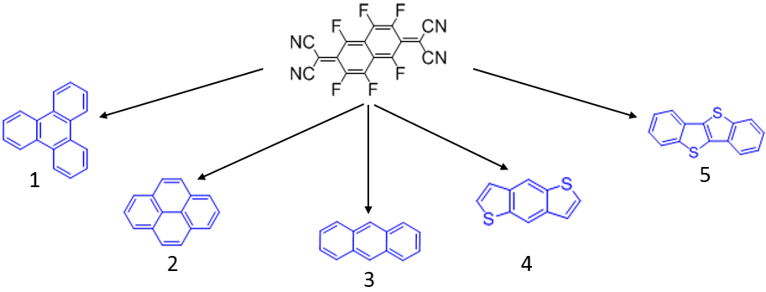
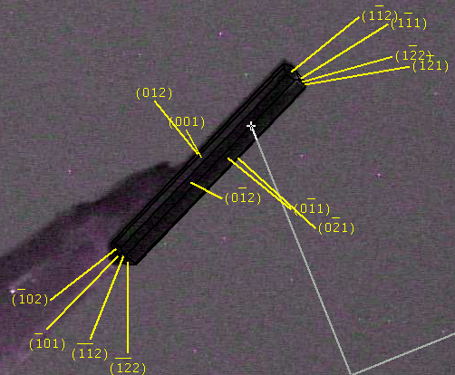
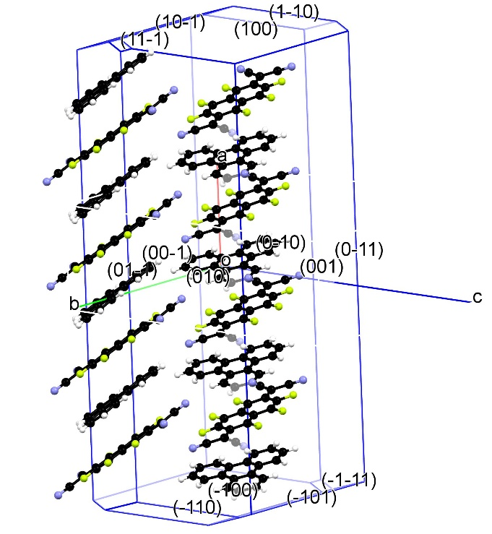
Donor - Acceptor Binary Organic Compounds – Charge Transfer (CT) Complexes
Partnership between NMHU and OSU in Electronic, Optical and Magnetic Materials; DMR-1523611
2017
Charge transfer materials are impor-
tant components of organic electronics for applications in OLED, solar batteries and transistors. Structure-properties relations for this
series of materials, including shapes of their crystals, were studied experimentally and computationally in connection with their internal structure using X-ray diffraction. For binary donor-acceptor materials (a) structures formed by molecular stacks (b) were found. Experimental (c) and computational (d) studies demonstrated that molecular stacks are oriented along elongated direction of the crystals. These knowledge are important for design and fabrication of devices based on CT materials.
Tatiana Timofeeva, New Mexico Highlands University
a
b
c
d
a) Schematic illustration of the initial donor and acceptor compounds; b) Space-filling presentation of molecular stacks in 1-5 (left to right);
c) Presentation of crystal shape of 5; d) Packing of 5 in crystal.

