Slide 1
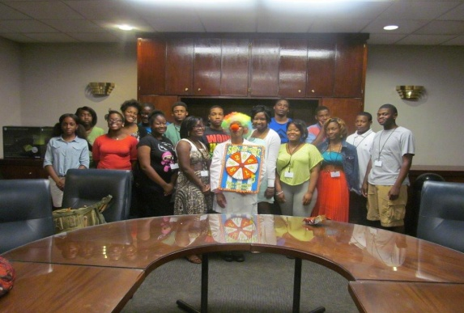
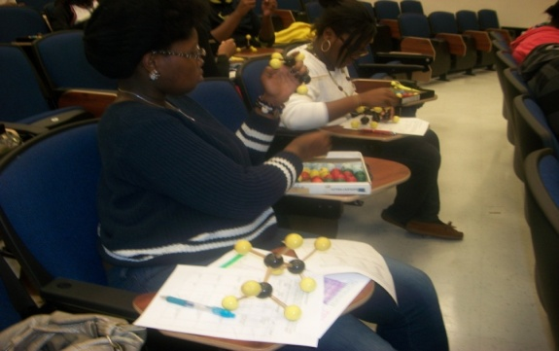
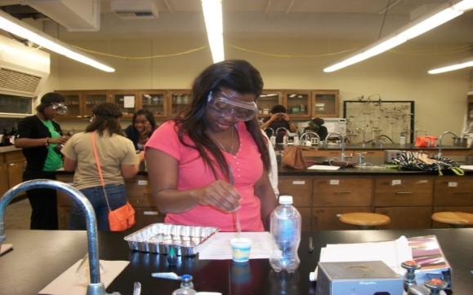
Nanotechnology Spin a Prize Game Show to for K12 Participants Paresh Ray (Jackson State University), DMR-Award # 1205194
NSF-JSU-UCSB PREM member conducted outreach activities at high school and initiate a Science Line program to help local science students in their mission of enhancing scientific literacy to wider audiences
PREM members hosted a Nanotechnology Spin a Prize Game Show to Wingfield High school participants

