Slide 1
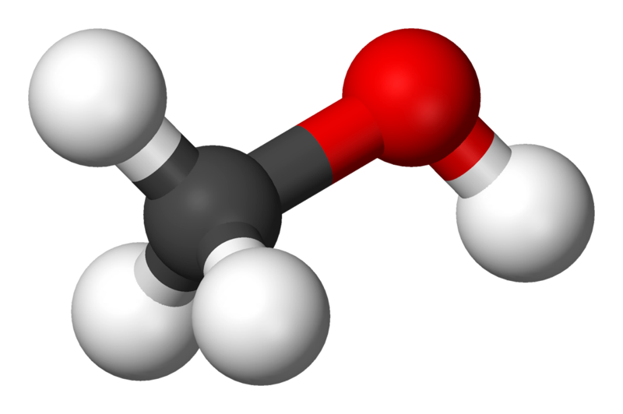
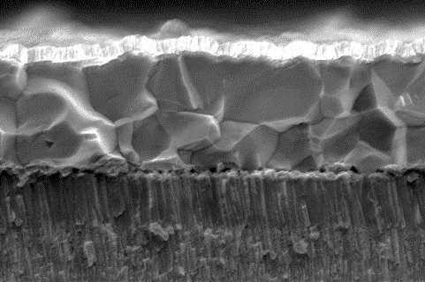
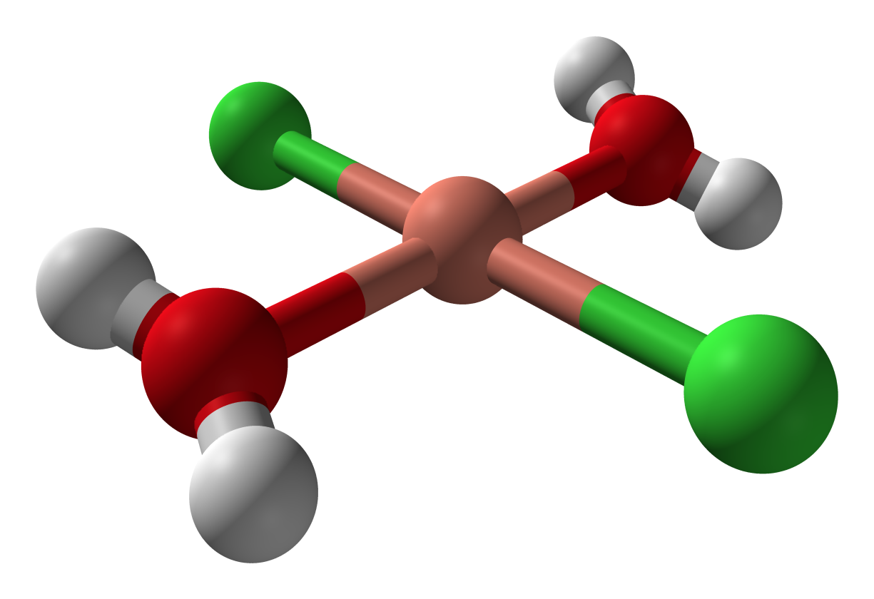
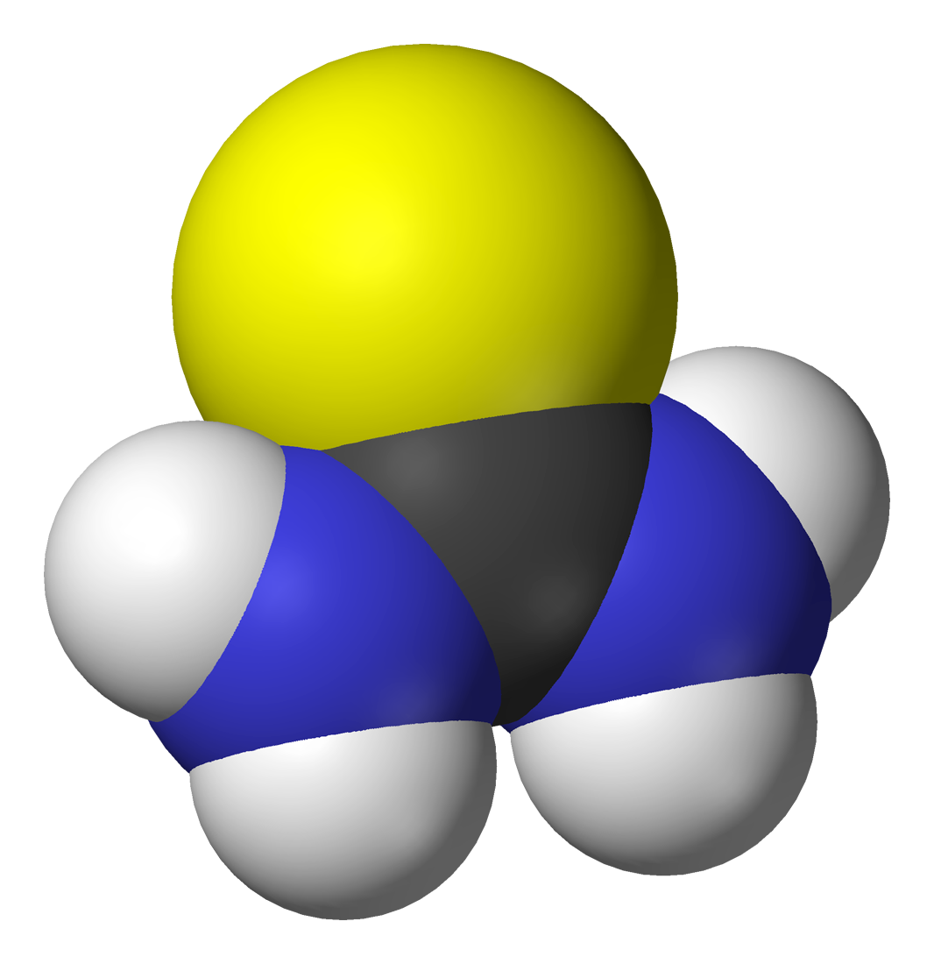
Defect Modeling, Characterization, and Engineering in Ordered Vacancy Compound Chalcopyrites for Photocatalytic and Photovoltaic Applications
DMR-2121848 PREM
UH: Gaillard (Thrust lead), Macabante, Septina, Dera. UW: Dunham, Tzanetopoulos, Roh, Holmberg, Pauzauskie, Gamelin.
PI: Severa, University of Hawai‘i at Mānoa
Defect passivation of printed chalcopyrites via in-situ Al₂O₃ incorporation
The goal of this project is to advance the knowledge of novel solar energy materials and understand the effect of defects on their optical and electronic properties.
Recently, the UH group discovered a new passivation technique to heal defects in chalcopyrites, a material class known for its high solar energy conversion efficiency. Specifically, the team demonstrated an efficiency enhancement of solution-processed chalcopyrite thin film solar cells via in-situ incorporation of Al₂O₃. This in-situ Al₂O₃ incorporation is speculated to play a role in the enhancement of the devices solid-state performance through passivation of defects reducing interface and bulk recombination, however, further analysis is required to identify which defects are passivated with Al₂O₃ treatment.
In this Task, UW provides analytical support, primarily photoluminescence (PL), to uncover specifically the role of Al₂O₃ treatment on defect passivation. Multiple samples containing various amounts of Al₂O₃ were synthesized by UH and analyzed at UW. All PL spectra revealed a pronounced peak at energy (1.7 eV) greater than the chalcopyrite absorber’s bandgap (1.0 eV) which is uncommon. The origin of this peak is still unknown, however, it could arise from secondary phases present at the surface of the chalcopyrite absorber after crystallization of the molecular ink. On-going analyses are performed to confirm the nature of this secondary phase and understand its impact on chalcopyrite photovoltaic performances.
Solar absorber printing from molecular ink (performed at UH)
Solvent
+
CuInSe₂
CuInSe₂
Metals
+
Mo
1 𝞵m
Chalcogen
Temperature-dependent photoluminescence (performed at UW)

