Slide 1
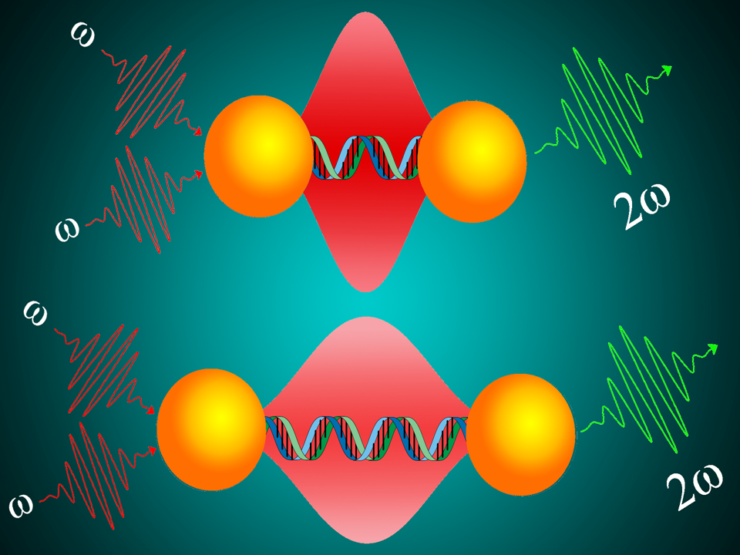
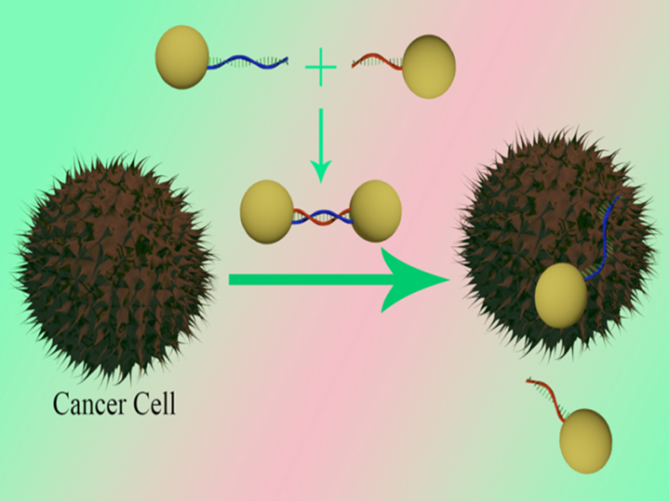
Nanomaterial Based Long-Range Ruler Can Screen Prostate Tumor Paresh Ray (Jackson State University), DMR-Award # 1205194
Since the ability to detect very low levels of prostate specific membrane antigen (PSMA) may enable doctors to diagnose men with prostate cancer recurrence, it has the capability to reduce prostate cancer-related mortality and morbidity.
We have developed long-range two-photon scattering (TPS) spectroscopy ruler using gold nano-antenna separated by bi-functional rigid double strand DNA molecule, which can be used for the screening of prostate-specific membrane antigen (PSMA) (+) prostate cancer cells even at 5 cells/mL level.
Published in Chem. Sci., 2015, 6, 2411 - 2418

